Slide 1

Priors, Part 2
DS6040 Fall 2024
Teague R. Henry

Slide 2

Outline
Priors Review
Eliciting Priors – Placenta Previa Example
Eliciting Priors - Kidney Cancer Example

Slide 3
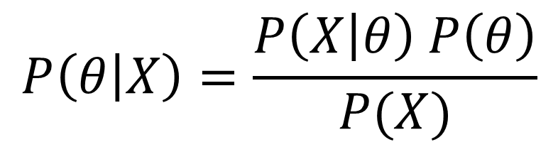

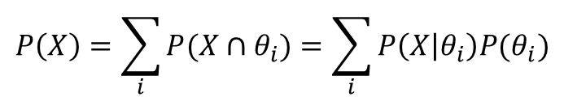
Bayes’ Theorem
Likelihood
(Probability of Data Given Model)
Posterior Distribution
(Probability of Model Given Data)
$$P\left(θ | X\right)=\frac{P\left(X | θ\right) P\left(θ\right)}{P(X)}$$
Prior Distribution
(Probability of Model)
$$P\left(X\right)=\sum_{i}{P(X∩θ_{i})}=\sum_{i}{P\left(X | θ_{i}\right)P(θ_{i})}$$
Marginal Distribution
(Probability of Data)
Probability of your data occurring for any choice of $θ$
Note: Possible $θ_{i}$ are constrained by the model type.

Slide 4
Priors Review
Priors represent our prior knowledge about the phenomena under study.
More specifically, they are probability distributions assigned to each parameter in a model that represent our prior beliefs about the location and uncertainty of the parameters.
There are many “classifications” of priors
Conjugate priors – priors that result in the posterior being from the same distributional family
Informative priors – priors that have something to say
Weakly/uninformative priors – priors without much information given
Key Point: A posterior represents a compromise between data and the priors

Slide 5
Placenta Previa
Placenta Previa is a material condition in which the placenta is located low in the uterus.
This blocks normal vaginal delivery, and if not accounted for, would result in hemorrhaging.
The question here is: Are male or female births more likely to have placenta previa?
Early study from Germany found that out of 980 PP births, 437 were female.
This example is taken from BDA3 by Gelman et al.

Slide 6
Placenta Previa – The likelihood
437/980 female births. We are interested in the proportion of female births relative to male births. Is it higher than .485, which is the proportion of female births in the overall population.
What is a reasonable likelihood for this data?
Our parameter of interest is a proportion.
Our data is # of female births out of # of total births.
An appropriate likelihood for this is the binomial distribution.
This example is taken from BDA3 by Gelman et al.

Slide 7
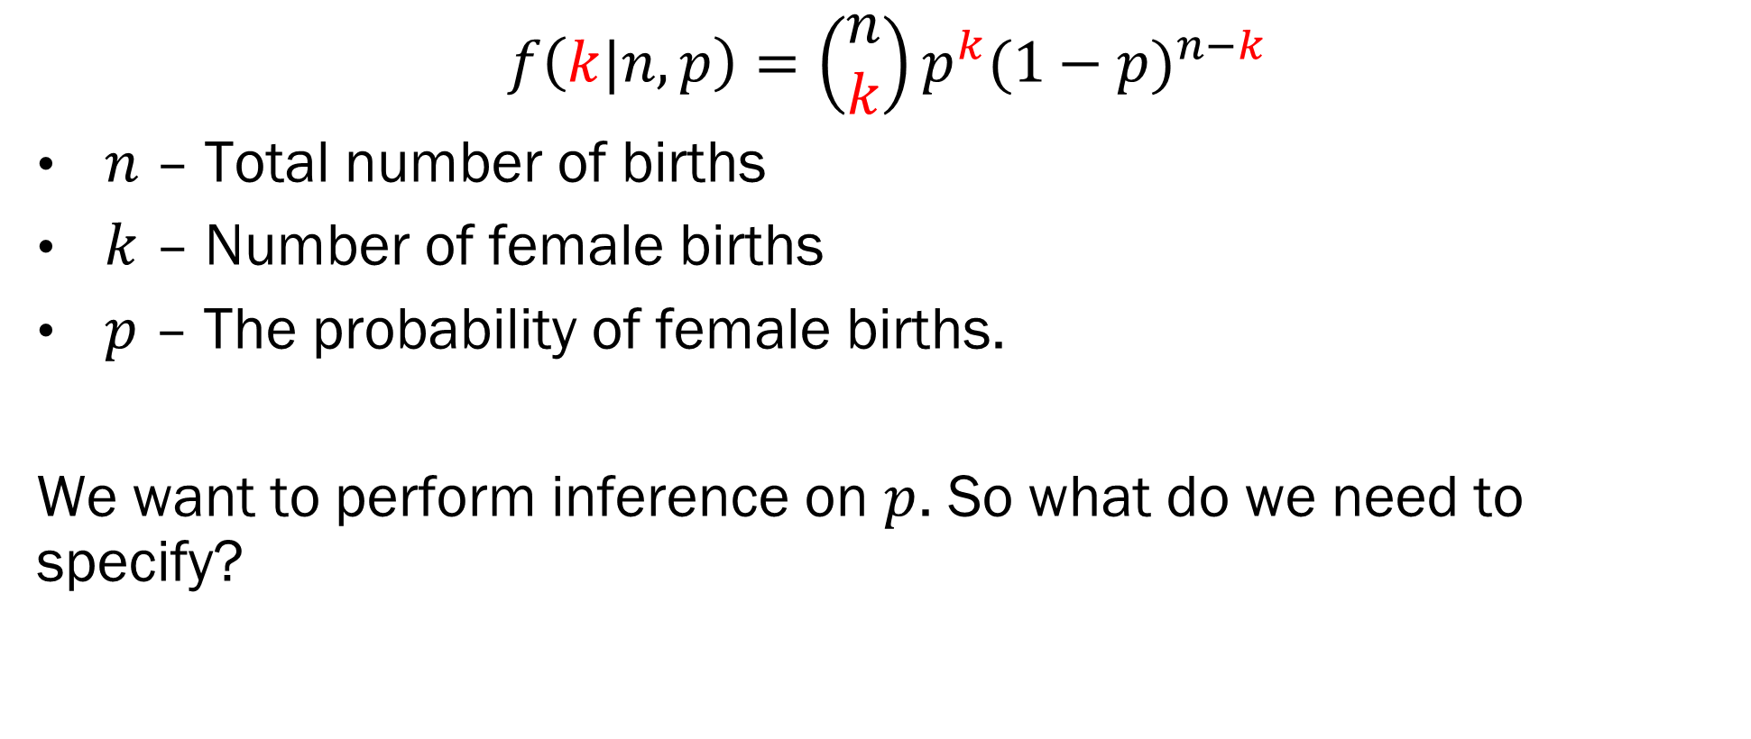
Binomial Likelihood
$$f\left(k|n,p\right)=\left(\begin{matrix}n \\ k\end{matrix}\right)p^{k}{(1−p)}^{n−k}$$
$n$ – Total number of births
$k$ – Number of female births
$p$ – The probability of female births.
We want to perform inference on $p$. So what do we need to specify?
This example is taken from BDA3 by Gelman et al.

Slide 8
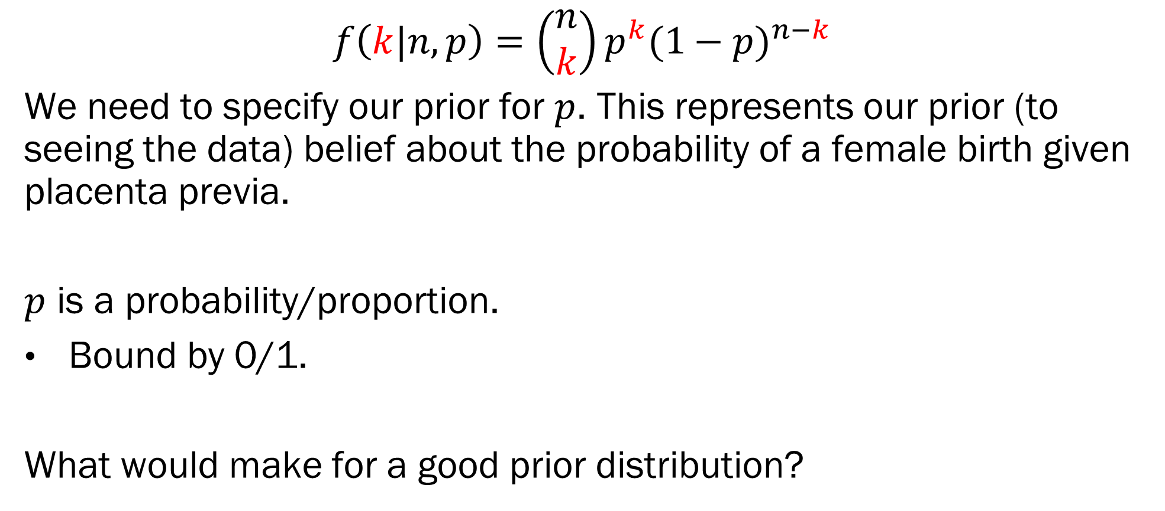
Prior Choice
$$f\left(k|n,p\right)=\left(\begin{matrix}n \\ k\end{matrix}\right)p^{k}{(1−p)}^{n−k}$$
We need to specify our prior for $p$. This represents our prior (to seeing the data) belief about the probability of a female birth given placenta previa.
$p$ is a probability/proportion.
Bound by 0/1.
What would make for a good prior distribution?
This example is taken from BDA3 by Gelman et al.

Slide 9
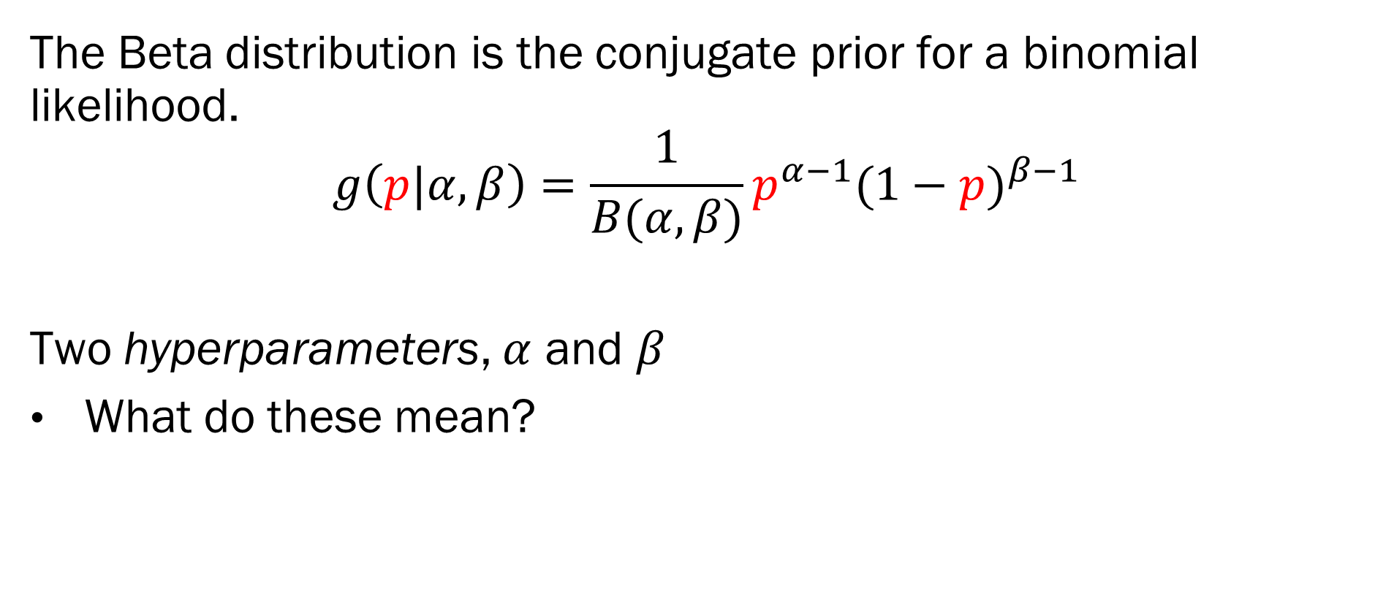
Prior Choice - Beta
The Beta distribution is the conjugate prior for a binomial likelihood.
$$g\left(p|α,β\right)=\frac{1}{B(α,β)}p^{α−1}{(1−p)}^{β−1}$$
Two hyperparameters, $α$ and $β$
What do these mean?
This example is taken from BDA3 by Gelman et al.

Slide 10
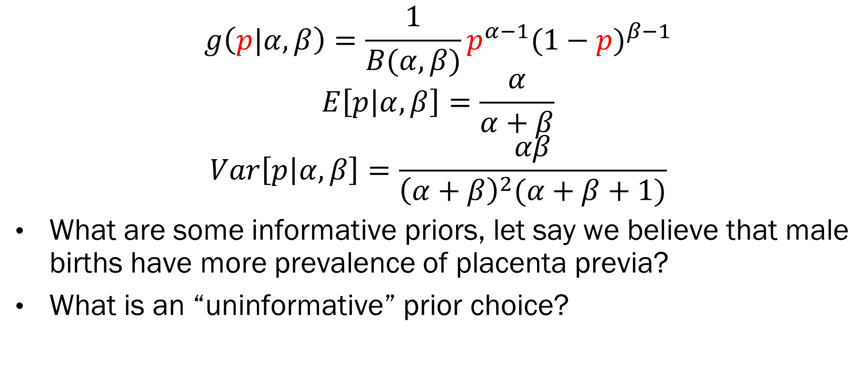
Prior Choice – Hyperparameters
$$g\left(p|α,β\right)=\frac{1}{B(α,β)}p^{α−1}{(1−p)}^{β−1}$$
$$E\left[p | α,β\right]=\frac{α}{α+β}$$
$$Var\left[p | α, β\right]=\frac{αβ}{{\left(α+β\right)}^{2}(α+β+1)}$$
What are some informative priors, let say we believe that male births have more prevalence of placenta previa?
What is an “uninformative” prior choice?
This example is taken from BDA3 by Gelman et al.

Slide 11
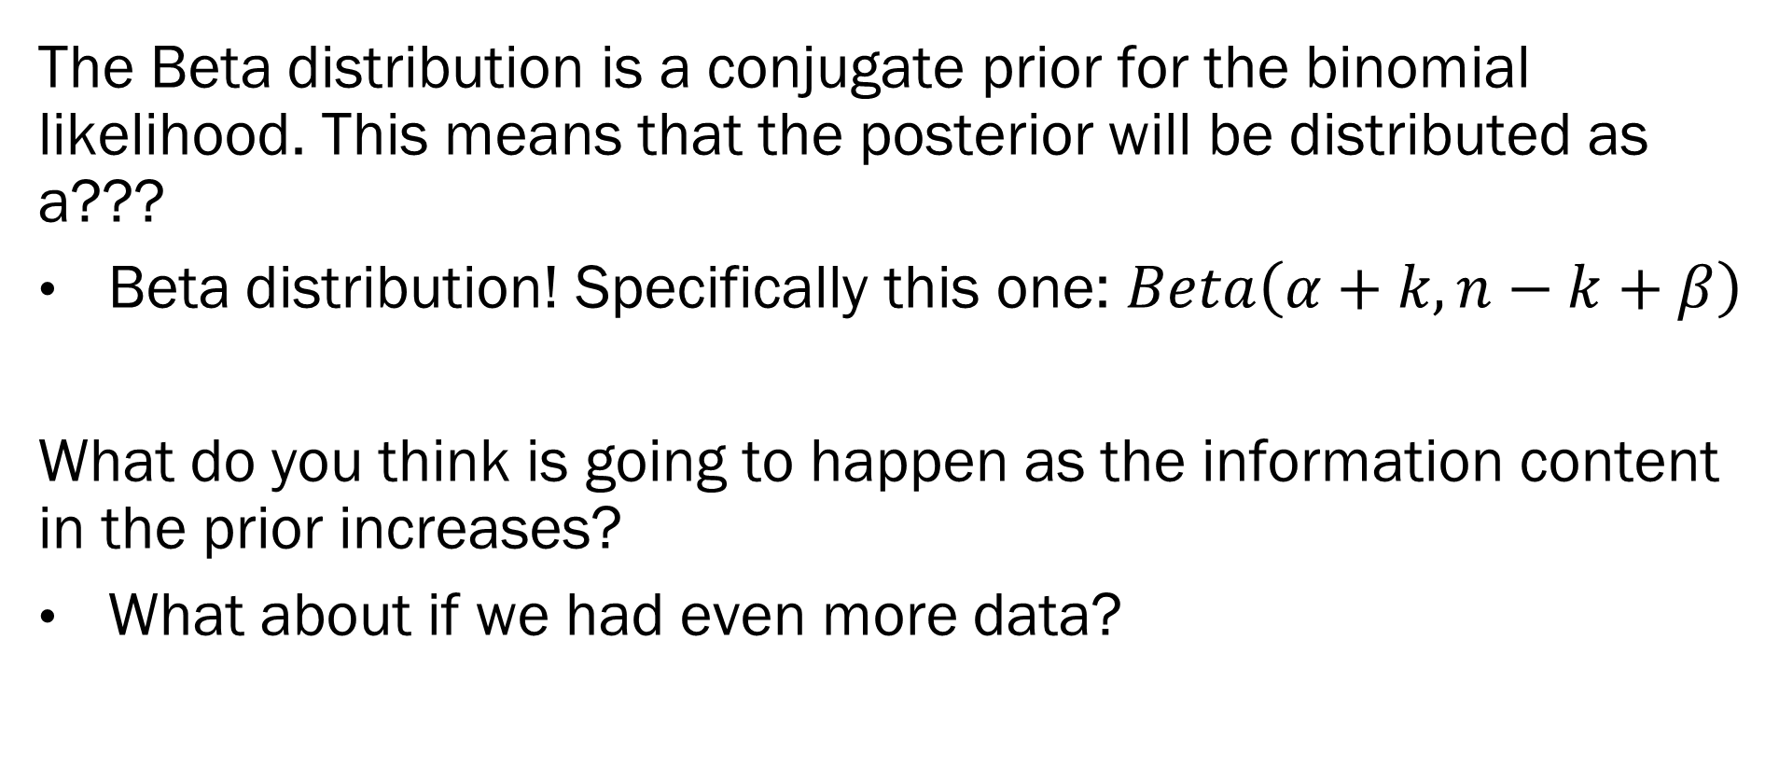
The Posterior
The Beta distribution is a conjugate prior for the binomial likelihood. This means that the posterior will be distributed as a???
Beta distribution! Specifically this one: $Beta\left(α+k, n−k+β\right)$
What do you think is going to happen as the information content in the prior increases?
What about if we had even more data?
This example is taken from BDA3 by Gelman et al.

Slide 12
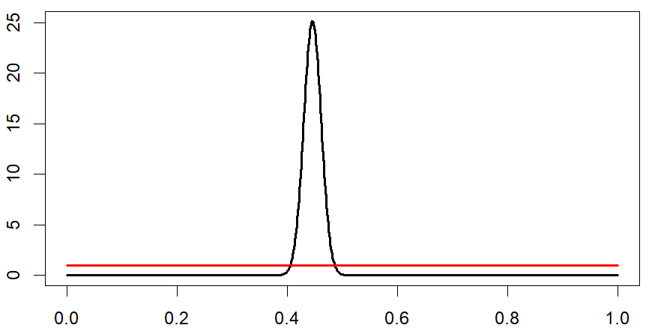
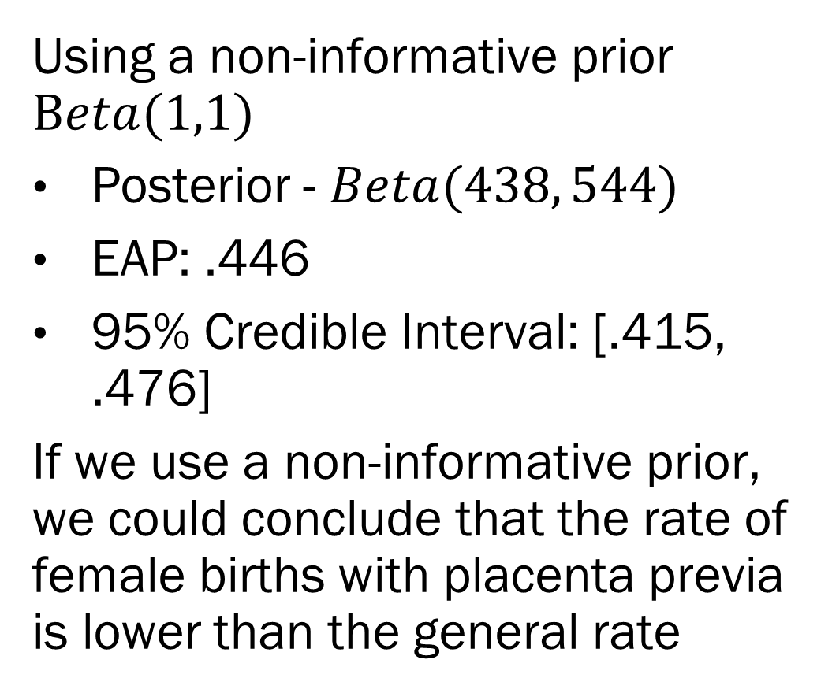
The Posterior
Using a non-informative prior $Beta(1,1)$
Posterior - $Beta(438, 544)$
EAP: .446
95% Credible Interval: [.415, .476]
If we use a non-informative prior, we could conclude that the rate of female births with placenta previa is lower than the general rate
This example is taken from BDA3 by Gelman et al.

Slide 13
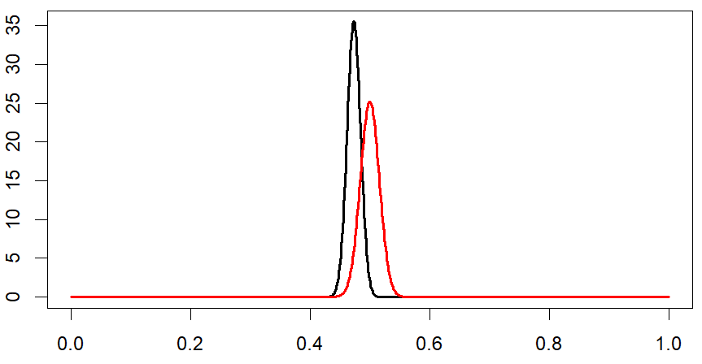
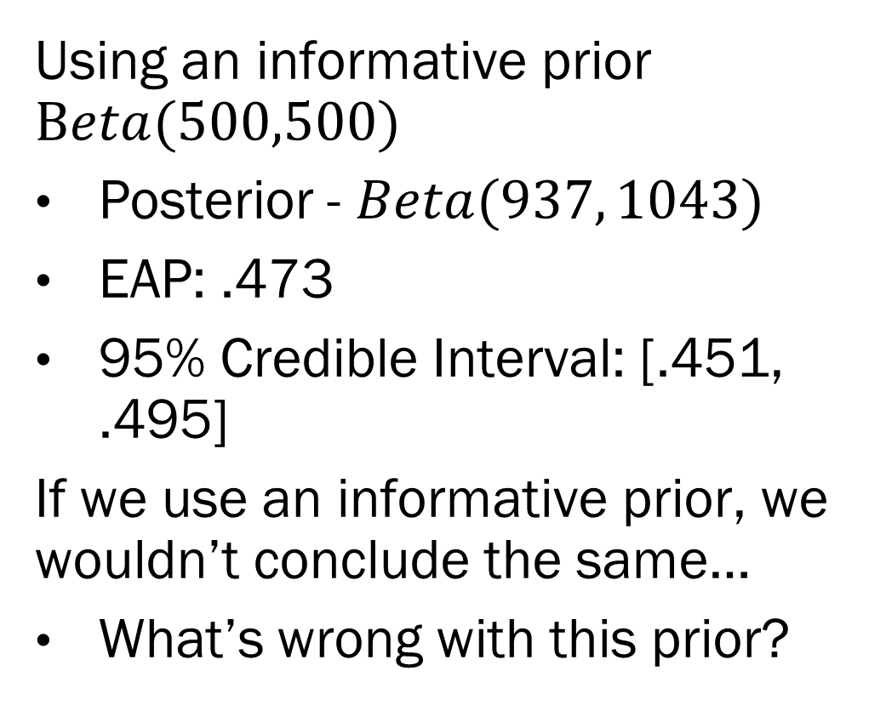
The Posterior
Using an informative prior $Beta(500,500)$
Posterior - $Beta(937, 1043)$
EAP: .473
95% Credible Interval: [.451, .495]
If we use an informative prior, we wouldn’t conclude the same…
What’s wrong with this prior?
This example is taken from BDA3 by Gelman et al.

Slide 14
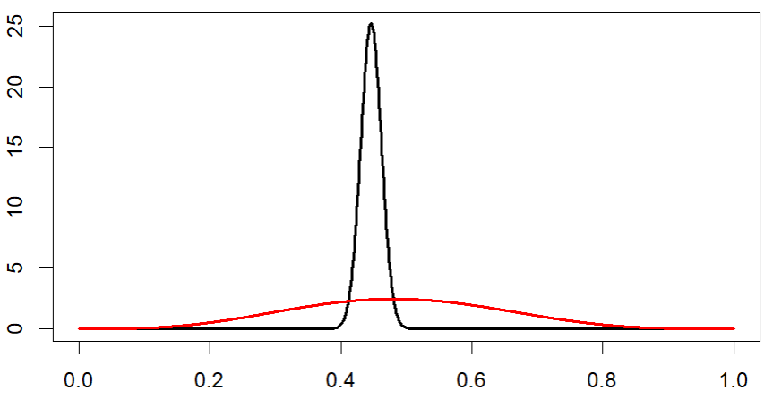
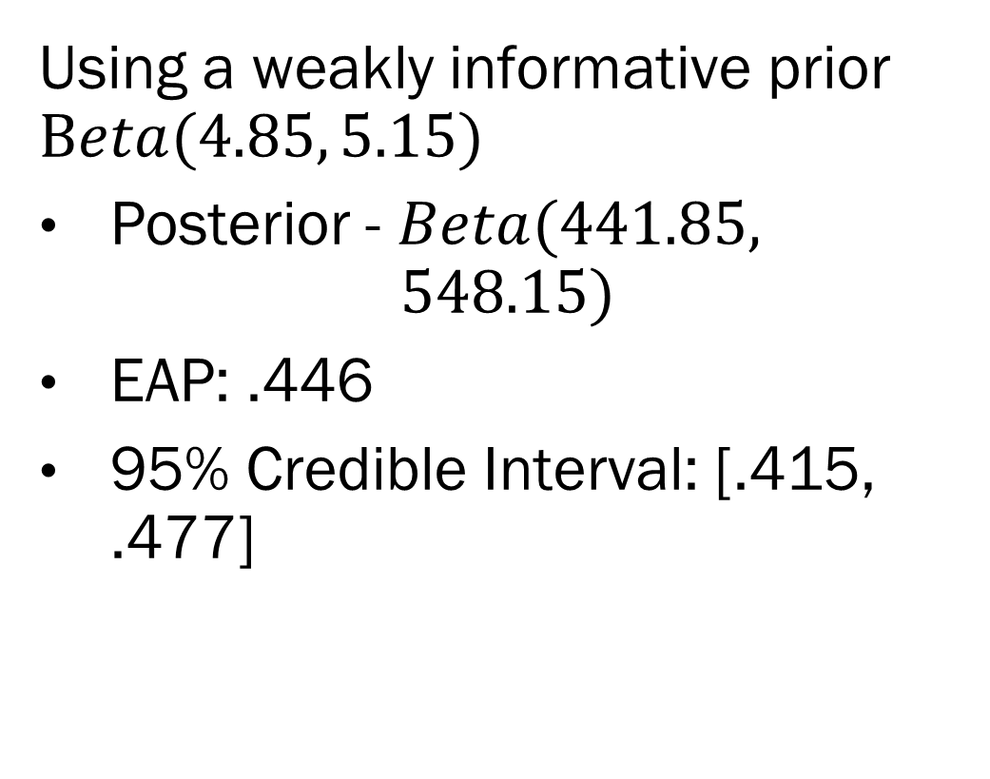
The Posterior
Using a weakly informative prior $Beta(4.85, 5.15)$
Posterior - $Beta(441.85,$
$$548.15)$$
EAP: .446
95% Credible Interval: [.415, .477]
This example is taken from BDA3 by Gelman et al.

Slide 15
Placenta Previa
Under a very simple model (binomial likelihood) with uninformative or weakly informative priors, we can conclude that female births are slightly less likely in placenta previa than in the general population.
So many caveats to this point…
Take away points:
Like all statistics, you can think about a prior in terms of location and uncertainty.
The informativeness of a prior is based on its uncertainty, not it’s location.
As data increases, the prior is overwhelmed.
This example is taken from BDA3 by Gelman et al.

Slide 16
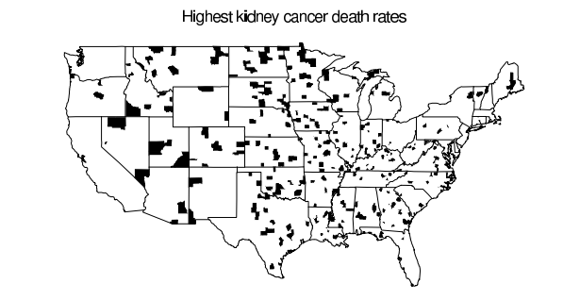
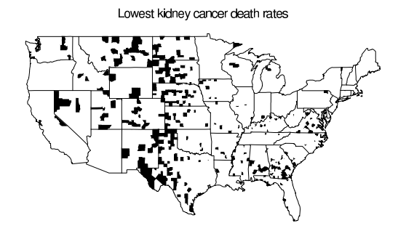
Kidney Cancer in the 1980s
This example is taken from BDA3 by Gelman et al.

Slide 17
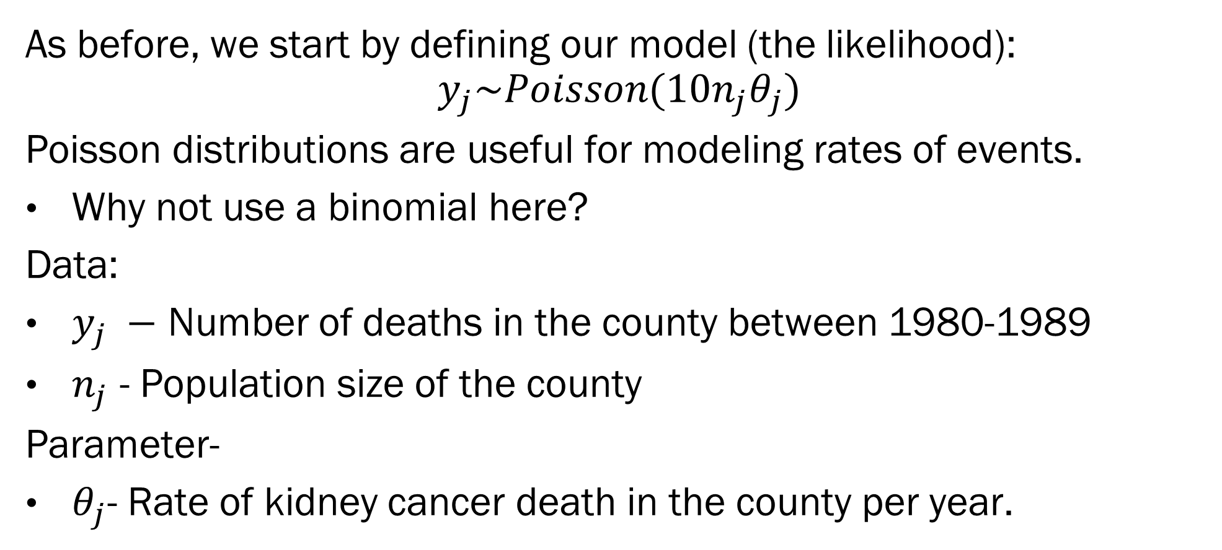
Kidney Cancer in the 1980s
As before, we start by defining our model (the likelihood):
$$y_{j}\sim Poisson(10n_{j}θ_{j})$$
Poisson distributions are useful for modeling rates of events.
Why not use a binomial here?
Data:
$y_{j} −$ Number of deaths in the county between 1980-1989
$n_{j}$ - Population size of the county
Parameter-
$θ_{j}$- Rate of kidney cancer death in the county per year.
This example is taken from BDA3 by Gelman et al.

Slide 18
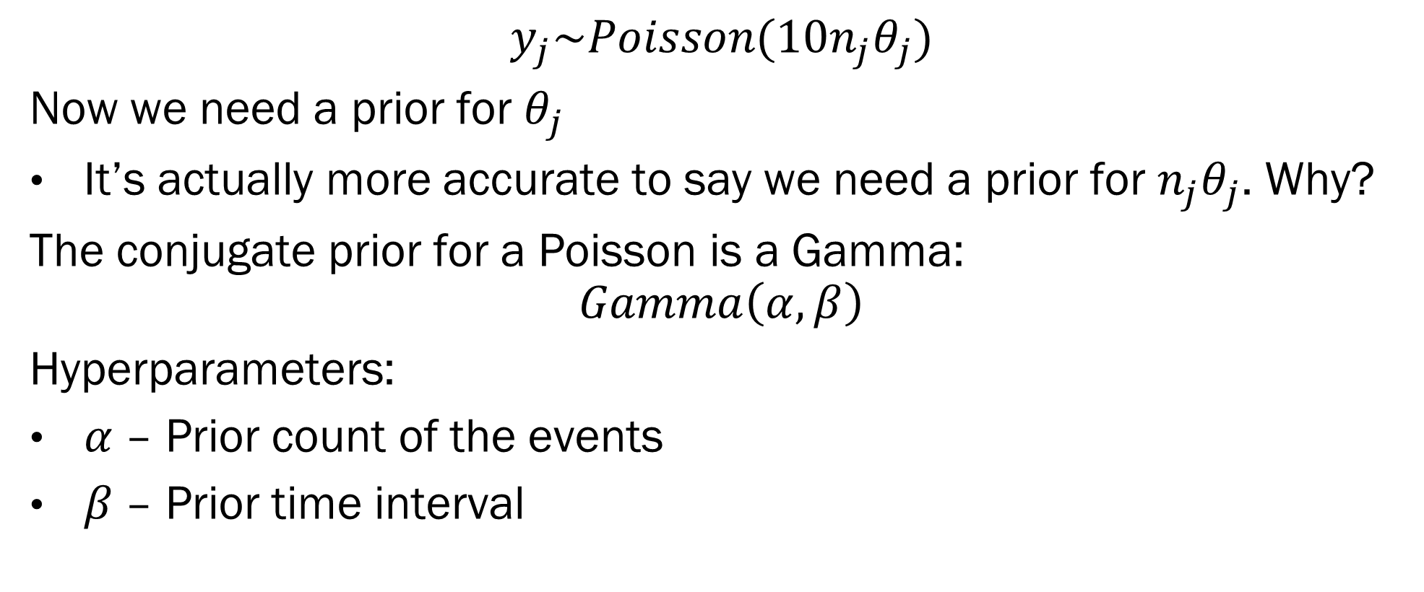
Kidney Cancer in the 1980s
$$y_{j}\sim Poisson({10n}_{j}θ_{j})$$
Now we need a prior for $θ_{j}$
It’s actually more accurate to say we need a prior for $n_{j}θ_{j}$. Why?
The conjugate prior for a Poisson is a Gamma:
$$Gamma\left(α, β\right)$$
Hyperparameters:
$α$– Prior count of the events
$β$– Prior time interval
This example is taken from BDA3 by Gelman et al.

Slide 19
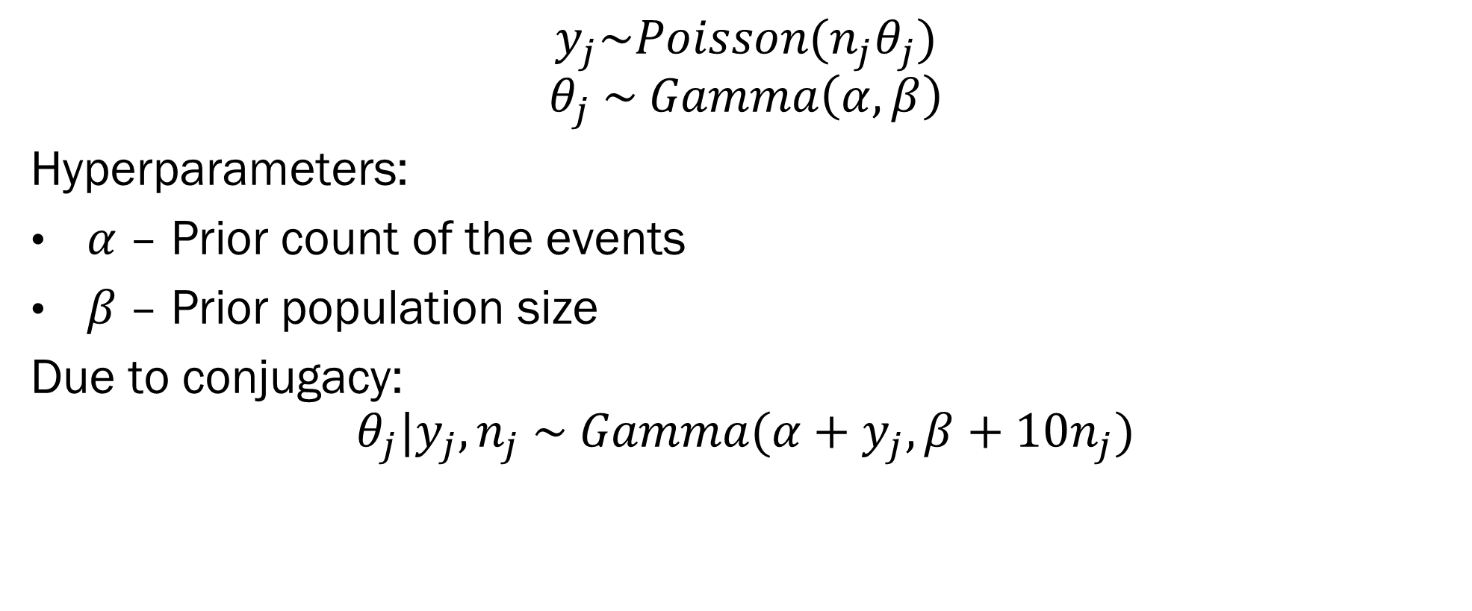
Kidney Cancer in the 1980s
$$y_{j}\sim Poisson(n_{j}θ_{j})$$
$$θ_{j} \sim Gamma\left(α, β\right)$$
Hyperparameters:
$α$– Prior count of the events
$β$– Prior population size
Due to conjugacy:
$$θ_{j}|y_{j}, n_{j} \sim Gamma(α+y_{j}, β+10n_{j})$$
This example is taken from BDA3 by Gelman et al.

Slide 20
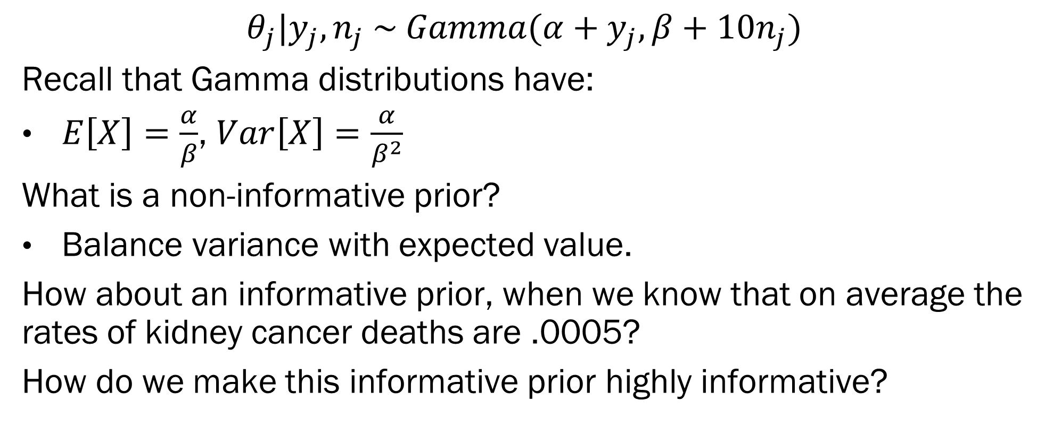
Kidney Cancer in the 1980s
$$θ_{j}|y_{j}, n_{j} \sim Gamma(α+y_{j}, β+10n_{j})$$
Recall that Gamma distributions have:
$E\left[X\right]=\frac{α}{β}$, $Var\left[X\right]=\frac{α}{β^{2}}$
What is a non-informative prior?
Balance variance with expected value.
How about an informative prior, when we know that on average the rates of kidney cancer deaths are .0005?
How do we make this informative prior highly informative?
This example is taken from BDA3 by Gelman et al.

Slide 21
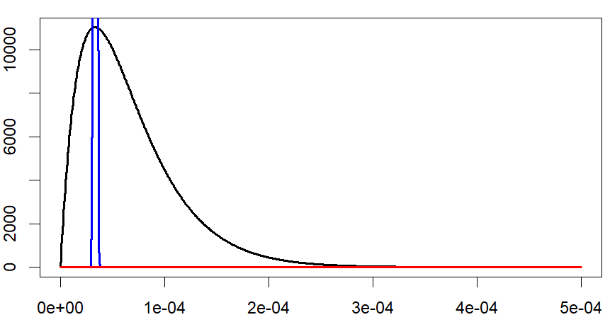
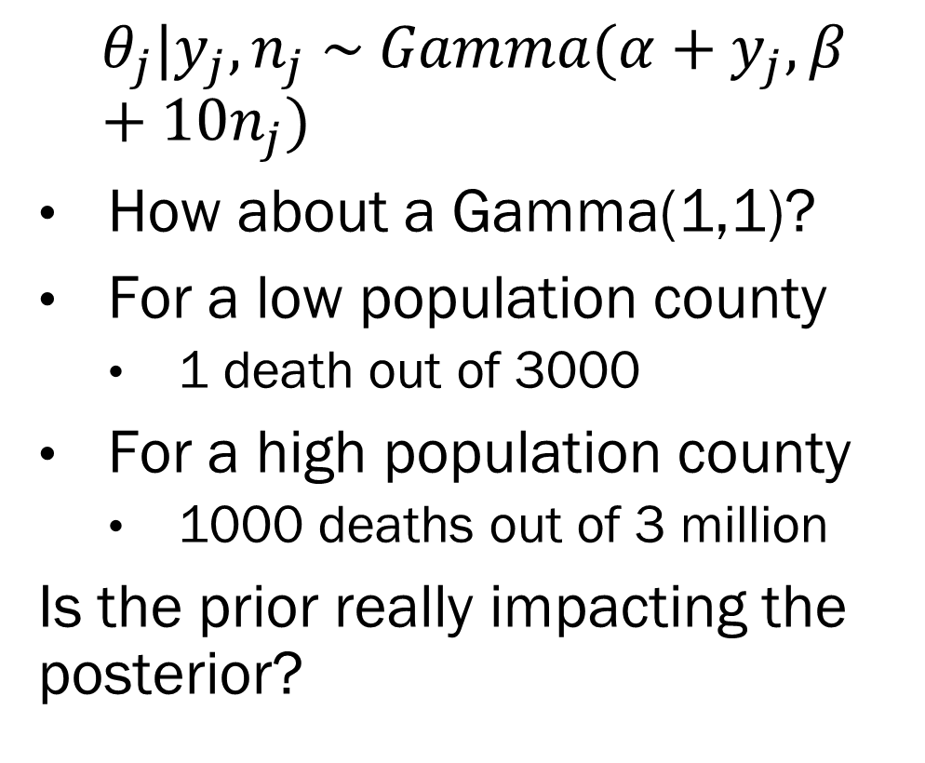
Non-Informative Prior
$$θ_{j}|y_{j}, n_{j} \sim Gamma(α+y_{j}, β+10n_{j})$$
How about a Gamma(1,1)?
For a low population county
1 death out of 3000
For a high population county
1000 deaths out of 3 million
Is the prior really impacting the posterior?
This example is taken from BDA3 by Gelman et al.

Slide 22
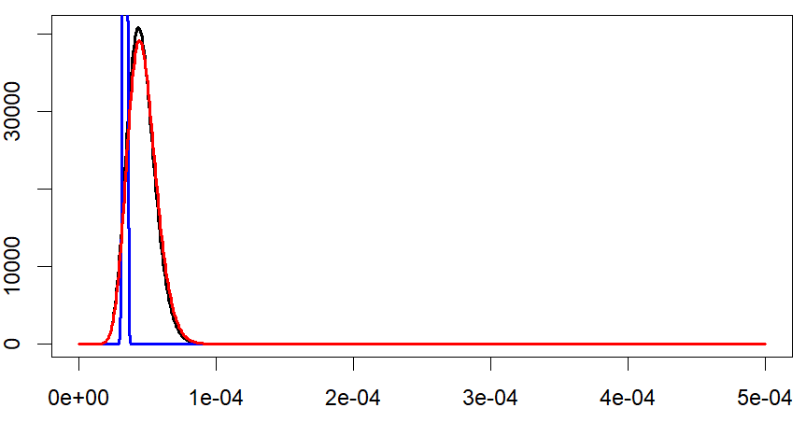
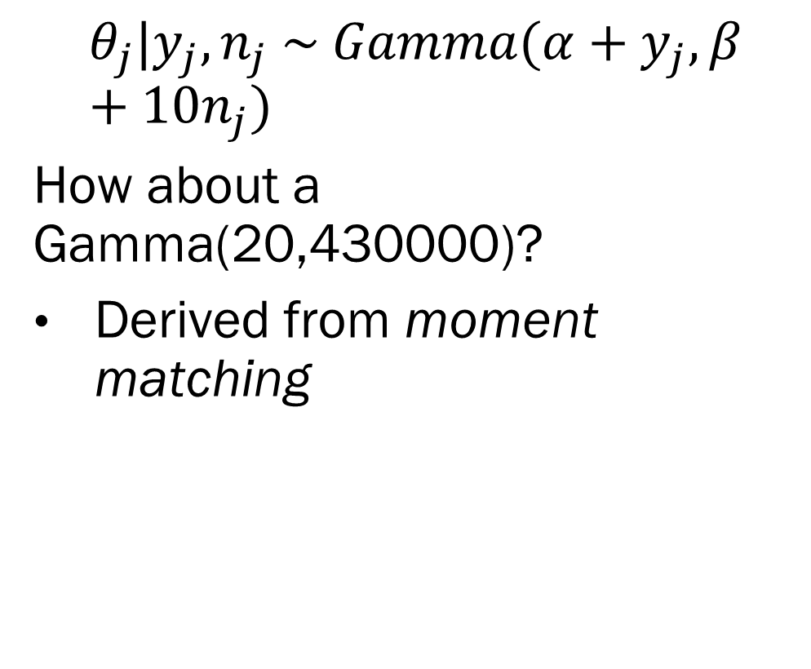
Non-Informative Prior
$$θ_{j}|y_{j}, n_{j} \sim Gamma(α+y_{j}, β+10n_{j})$$
How about a Gamma(20,430000)?
Derived from moment matching
This example is taken from BDA3 by Gelman et al.

Slide 23
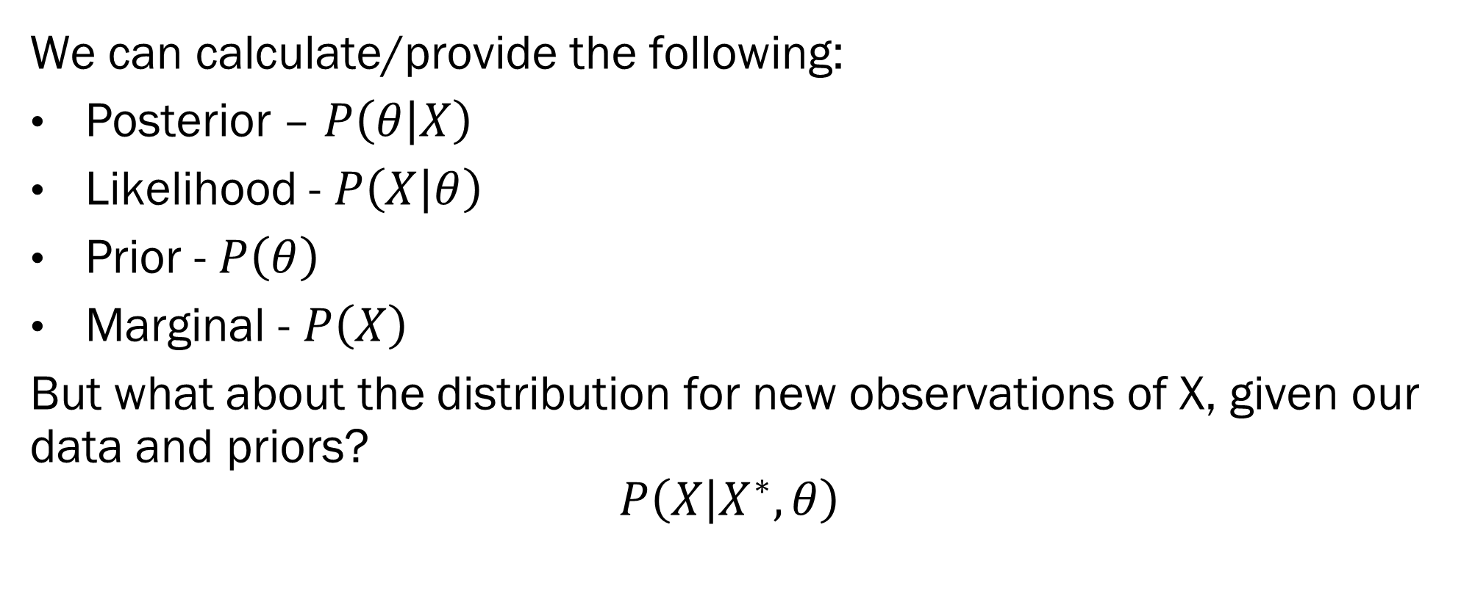
New Concept: Predictive Distribution
We can calculate/provide the following:
Posterior – $P\left(θ | X\right)$
Likelihood - $P\left(X | θ\right)$
Prior - $P\left(θ\right)$
Marginal - $P\left(X\right)$
But what about the distribution for new observations of X, given our data and priors?
$$P\left(X | X^{∗}, θ\right)$$
This example is taken from BDA3 by Gelman et al.

Slide 24
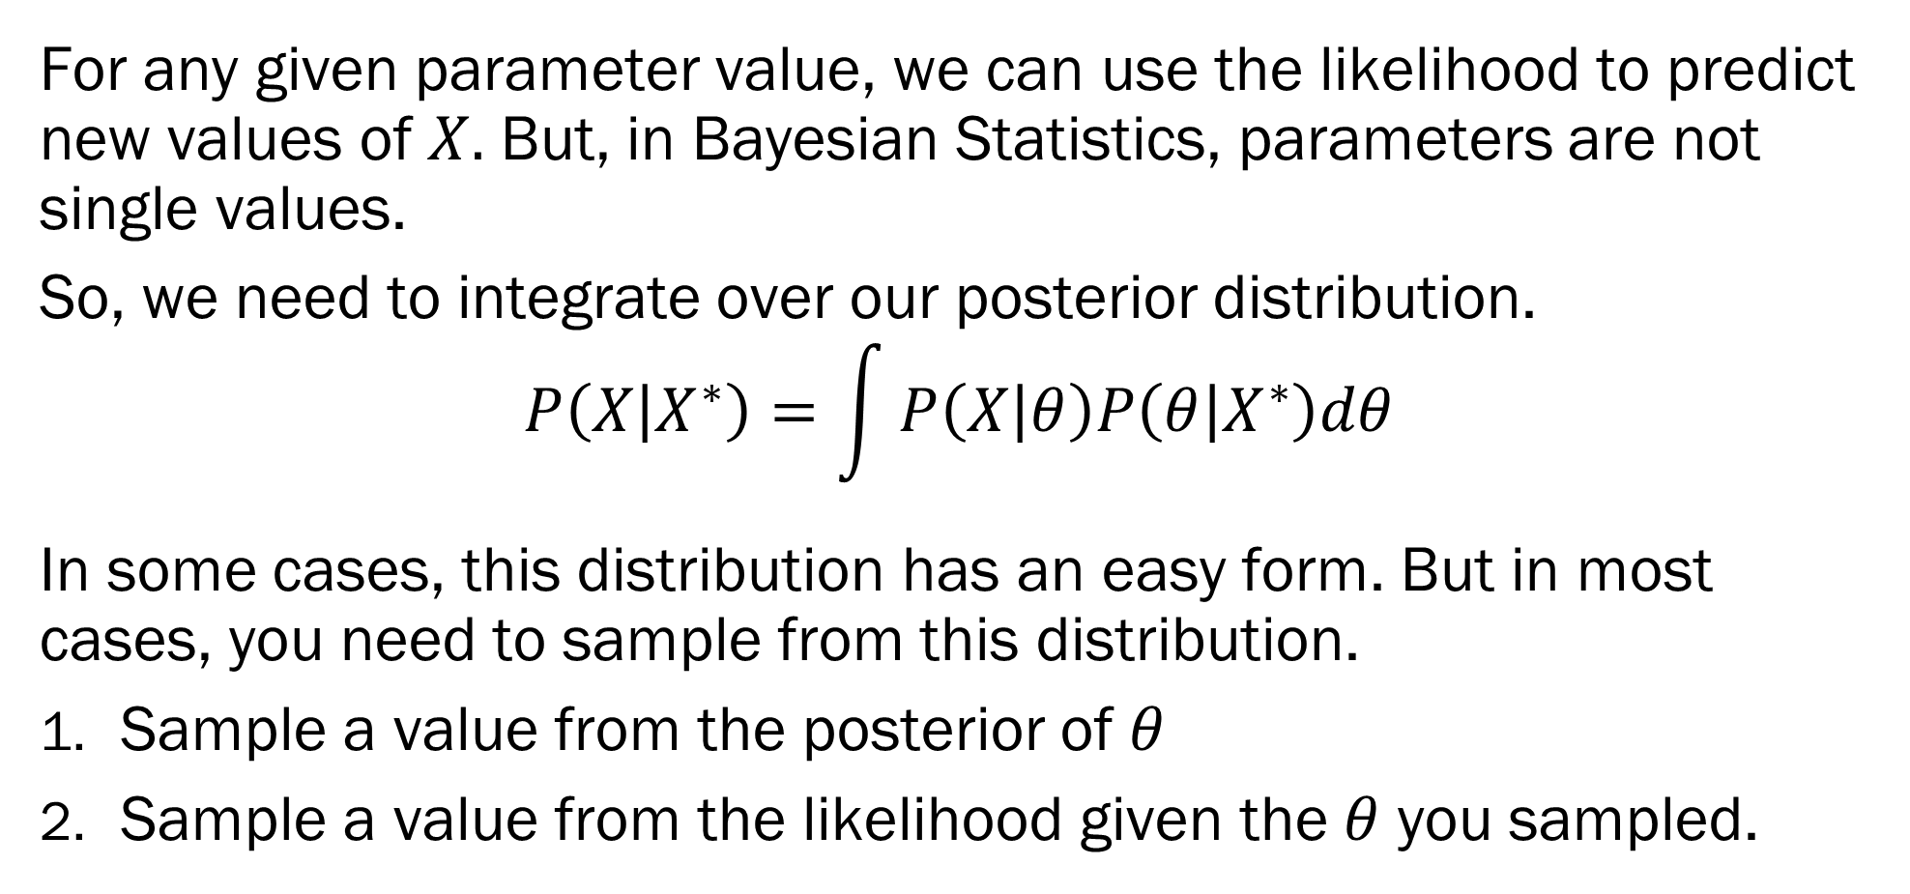
Predictive Distribution
For any given parameter value, we can use the likelihood to predict new values of $X.$ But, in Bayesian Statistics, parameters are not single values.
So, we need to integrate over our posterior distribution.
$$P\left(X | X^{∗}\right)=\int{P\left(X | θ\right)P\left(θ | X^{∗}\right)dθ}$$
In some cases, this distribution has an easy form. But in most cases, you need to sample from this distribution.
Sample a value from the posterior of $θ$
Sample a value from the likelihood given the $θ$ you sampled.
This example is taken from BDA3 by Gelman et al.

Slide 25
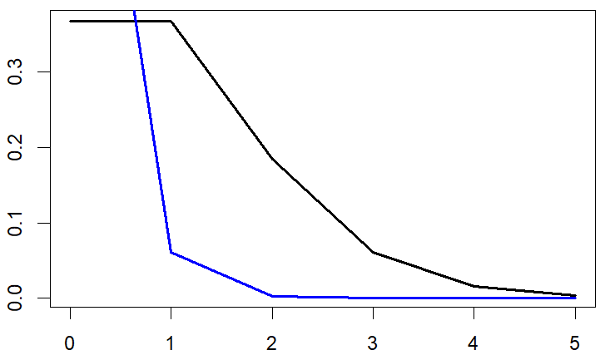
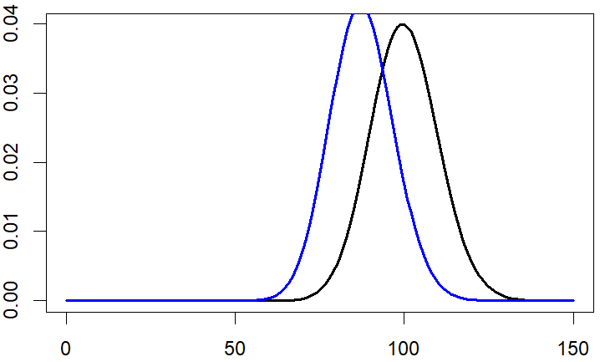
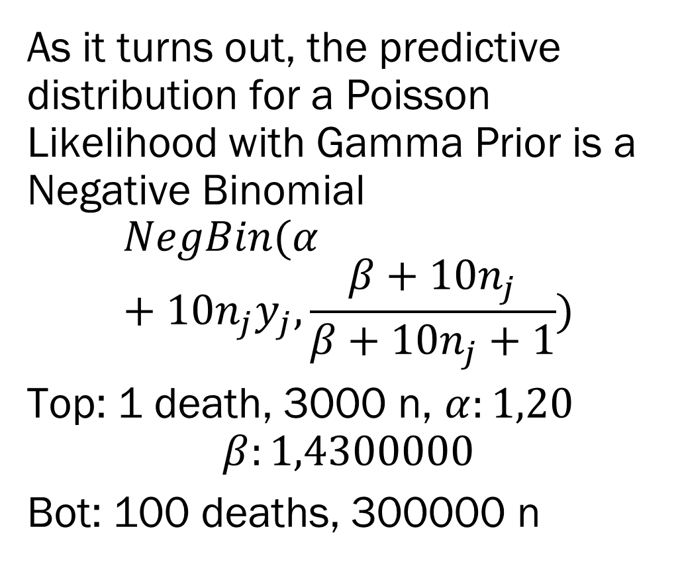
Back to Kidney Cancer
As it turns out, the predictive distribution for a Poisson Likelihood with Gamma Prior is a Negative Binomial
$$NegBin(α+10n_{j}y_{j},\frac{β+10n_{j}}{β+10n_{j}+1})$$
Top: 1 death, 3000 n, $α:1,20$
$$β:1,4300000$$
Bot: 100 deaths, 300000 n
This example is taken from BDA3 by Gelman et al.

Slide 26
Next Week on Bayes ML
Tuesday
Bayesian Classification
Conjugate Bayesian Regression
Thursday
- Bayesian Inference and Samplers!
This example is taken from BDA3 by Gelman et al.

